Slide 1
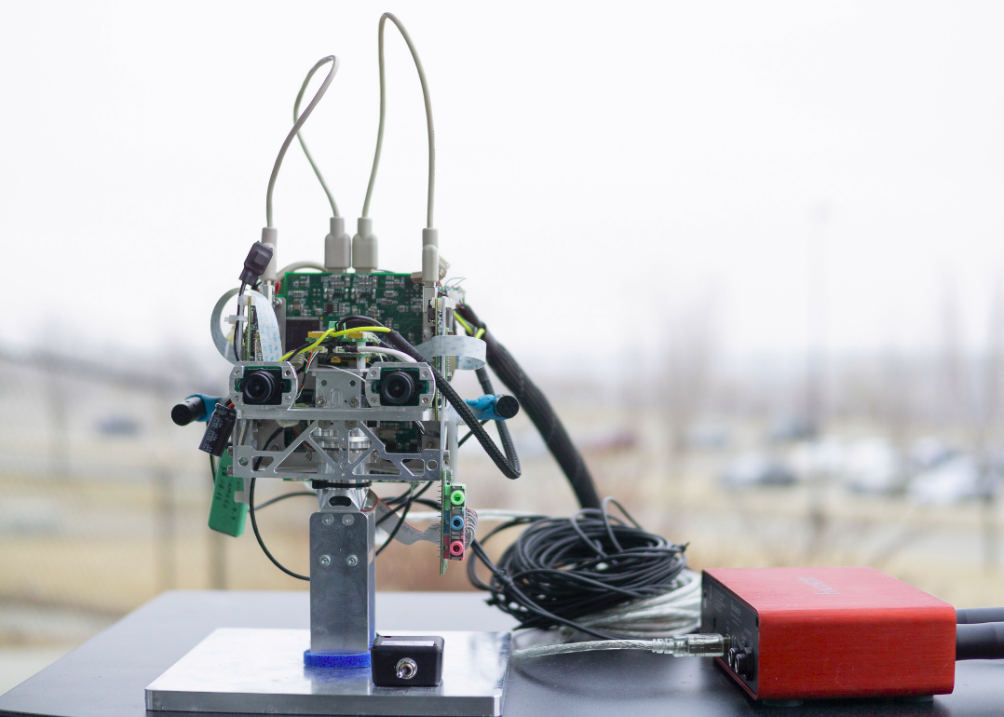
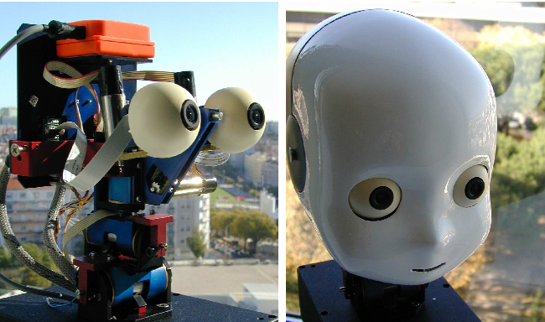
A Bayesian System for Noise
Robust Binaural Speaker Counting for Humanoid Robots Matthew Tata, Austin Kothig, and Francesco Rea

Slide 2
Computational Implementation
To describe a biologically inspired computational model for localizing speakers [2,3] by a binaural humanoid robot iCub [1]
To enrich a Bayesian active hearing algorithm [4] that uses instantaneous egocentric evidence to update an
allocentric posterior map
To extend the algorithm to test whether use of the 5hz envelope dynamics of speech can help to reject distractor sound sources.
Notes:
two approaches:
in the Amplitude Only condition, the RMS amplitude of each band x beam signal is computed.
In the Envelope condition, the 5hz envelope modulations due to speech are extracted from each band x beam signal by computing the absolute value of the Hilbert transform, then band-pass filtering the envelope and collapsing across time using RMS.
The creation of the acoustic Bayesian map (ABM) is defined by the product of all the allocentric acoustic maps (AMallo) and approximates the output of the inferior colliculus of the mammalian auditory pathway.
Thus the Amplitude Only ABM describes the spectrospatial scene unmixed on the basis of signal amplitude, whereas the Envelope ABM represents the spectrospatial scene unmixed on the basis of 5hz envelope dynamics.
To arrive at a single posterior distribution of sound sources across the azimuthal plane, we averaged across frequency bands, yeilding a distribution of belief that a sound source occupied a particular azimuthal angle. Each peak in this distribution can be considered a sound source and a candidate for target selection

Slide 3
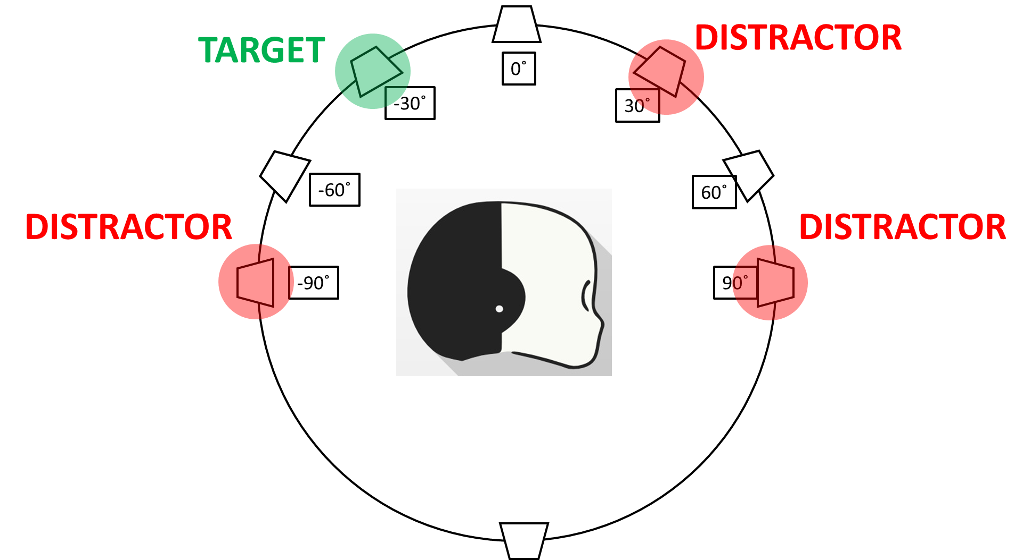
Experiment
Does the system reliably reports the presence and location of human voice regardless of competing noise sources?
We reproduced auditory targets and distractors (pink noise) in free field in the auditory virtual-reality lab.

Slide 4
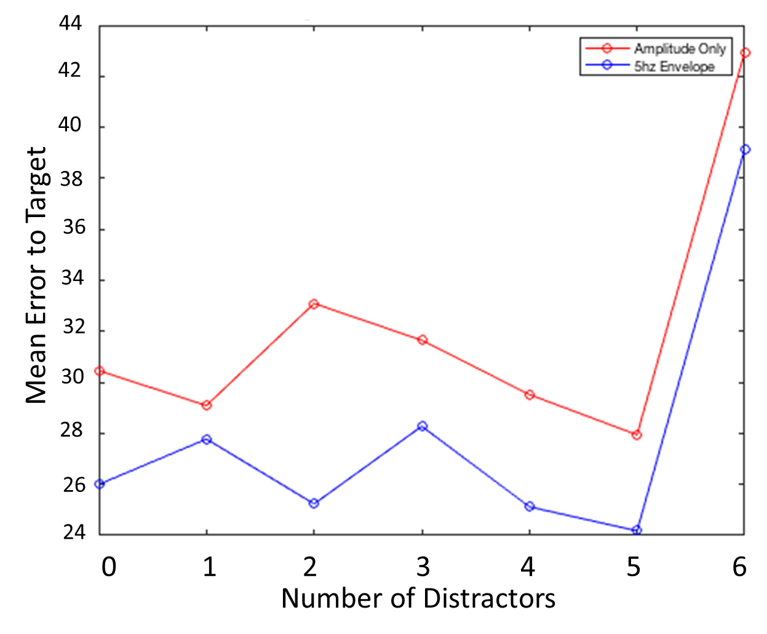
Result
In counting and localizing the single candidate target shows that
Envelop approach is unaffected by increasing number of distractors.
COUNT TARGETS
LOCALIZATION ERROR
A repeated-measures ANOVA with set-size and envelope approach supported this significant interaction (F 6,1668 = 4.9; p<0.001)

Slide 5
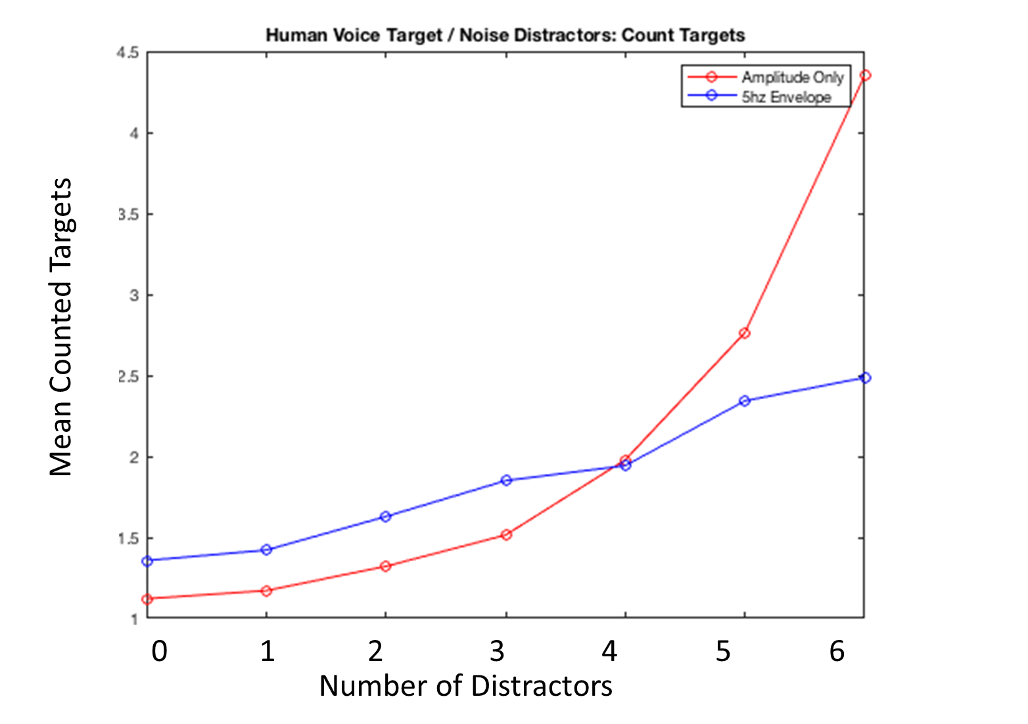
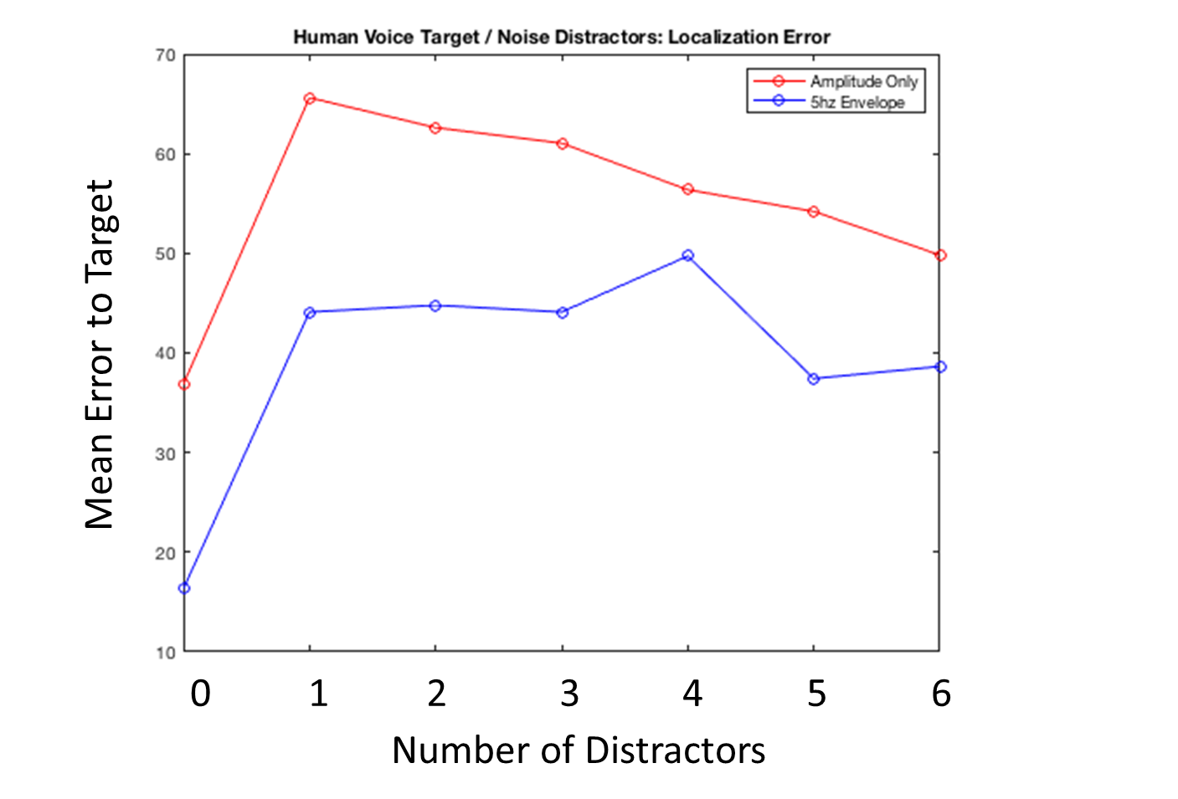
Human Voice Target / Noise Distractor
COUNT TARGETS
LOCALIZATION ERROR

Slide 6
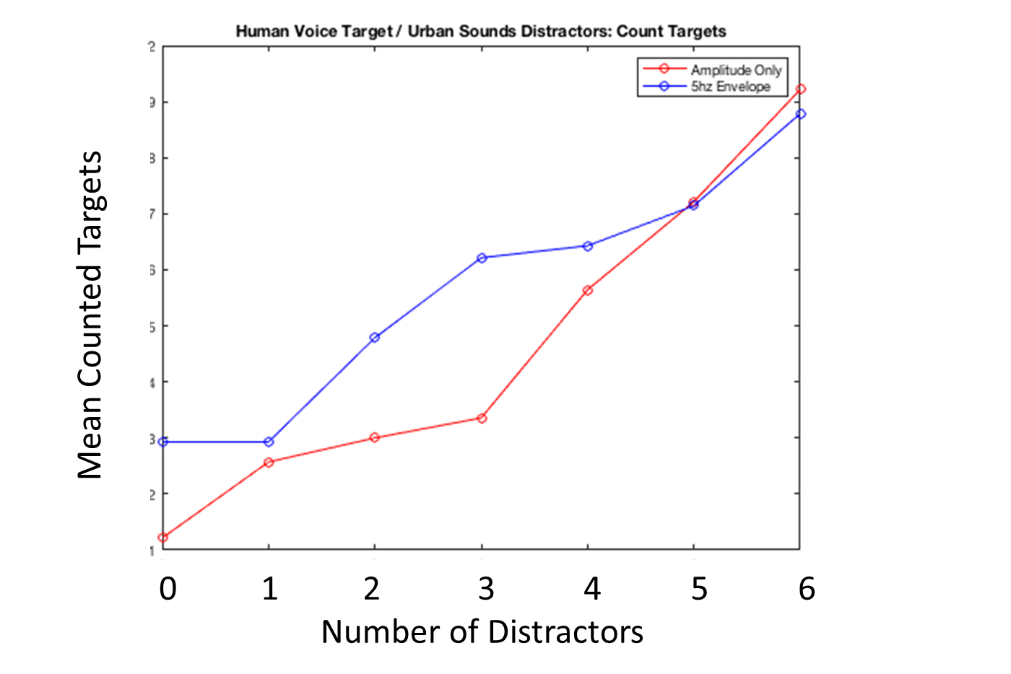
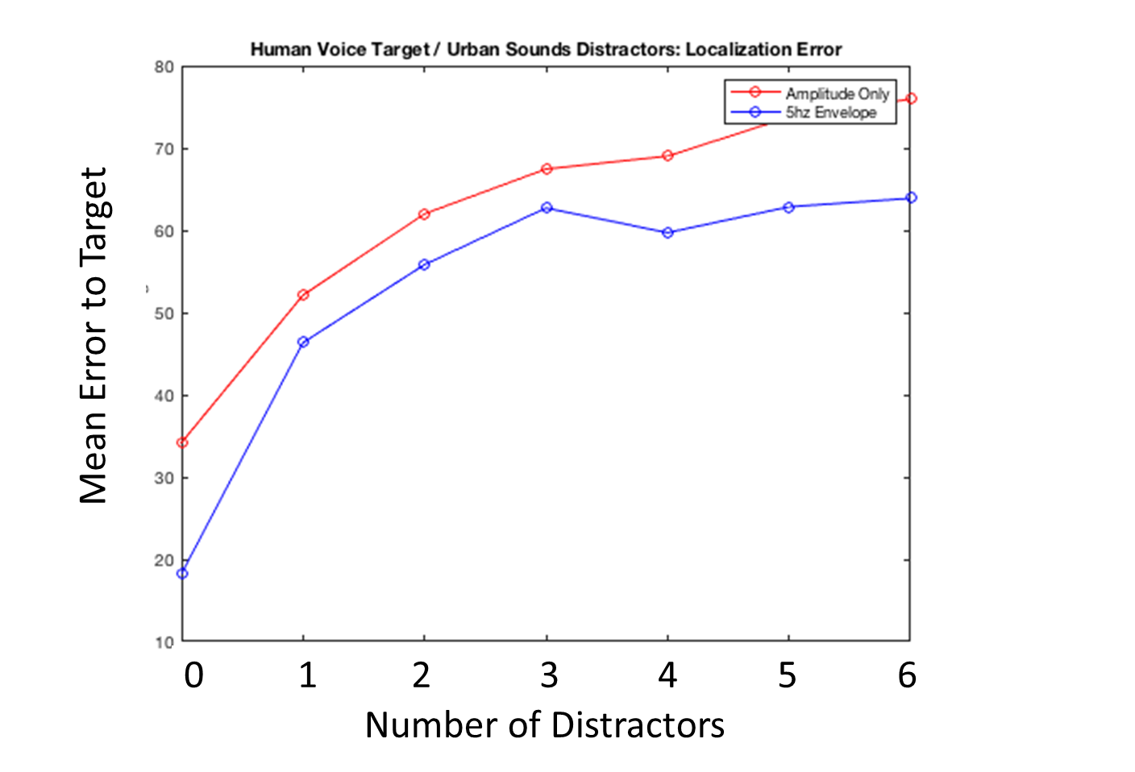
Human Voice Target / Urban Sounds Distractors
COUNT TARGETS
LOCALIZATION ERROR

Slide 7
5hz AM Target / Noise Distractors
Counting |  | SumSQ | DF | MeanSq | F | p | Greenhouse-Geiser
 | SetSize | 60,1908163 | 6 | 10,0318027 | 9,58306412 | 2,20E-10 | 1,62E-09
 | Filter x SetSize | 30,8459184 | 6 | 5,14098639 | 4,91102184 | 5,47E-05 | 0,000117306
 | error | 1746,10612 | 1668 | 1,04682621 | 1 | 0,5 | 0,5
Error |  | SumSQ | DF | MeanSq | F | p | Greenhouse-Geiser
 | SetSize | 42300,3357 | 6 | 7050,05595 | 3,73882988 | 1,06E-03 | 1,41E-03
 | Filter x SetSize | 1597,21939 | 6 | 266,203231 | 0,14117457 | 9,91E-01 | 0,988299429
 | error | 3145233,59 | 1668 | 1885,63165 | 1 | 0,5 | 0,5
Group Main Effect |  | mean difference | StdError | p
'amp' | 'env' | -0,298979592 | 0,047968867 | 5,63E-10
'amp' | 'env' | 4,137755102 | 2,048018716 | 0,04334505

Slide 8
Human Voice Target / Noise Distractors
Counting |  | SumSQ | DF | MeanSq | F | p | Greenhouse-Geiser
 | SetSize | 1049,6 | 6 | 174,933333 | 146,077742 | 4,60E-149 | 4,46E-108
 | Filter x SetSize | 264,338776 | 6 | 44,0564626 | 36,7892641 | 4,69E-42 | 5,47E-31
 | error | 1997,4898 | 1668 | 1,19753585 | 1 | 0,5 | 0,5
Error |  | SumSQ | DF | MeanSq | F | p | Greenhouse-Geiser
 | SetSize | 168020,332 | 6 | 28003,3886 | 13,1549126 | 1,34E-14 | 4,58E-14
 | Filter x SetSize | 11648,2214 | 6 | 1941,37024 | 0,91198091 | 4,85E-01 | 0,482046551
 | error | 3550738,3 | 1668 | 2128,73999 | 1 | 0,5 | 0,5
Group Main Effect |  | mean difference | StdError | p
'amp' | 'env' | 0,170408163 | 0,046117612 | 0,00021982
'amp' | 'env' | 15,91428571 | 2,127831594 | 1,06E-10

Slide 9
Human Voice Target / Urban Sounds Distractors
Counting |  | SumSQ | DF | MeanSq | F | p | Greenhouse-Geiser
 | SetSize | 102,638776 | 6 | 17,1064626 | 24,6305867 | 4,24E-28 | 1,06E-23
 | Filter x SetSize | 5,75714286 | 6 | 0,95952381 | 1,38156175 | 2,18E-01 | 0,22863497
 | error | 1158,46122 | 1668 | 0,69452112 | 1 | 0,5 | 0,5
Error |  | SumSQ | DF | MeanSq | F | p | Greenhouse-Geiser
 | SetSize | 398902,542 | 6 | 66483,757 | 28,6750963 | 8,67E-33 | 9,64E-32
 | Filter x SetSize | 6813,69082 | 6 | 1135,61514 | 0,48980194 | 8,16E-01 | 0,810225562
 | error | 3867289,77 | 1668 | 2318,51905 | 1 | 0,5 | 0,5
Group Main Effect |  | mean difference | StdError | p
'amp' | 'env' | -0,1 | 0,037153803 | 0,00711284
'amp' | 'env' | 9,269387755 | 2,012262111 | 4,10E-06

